Slide 1
GRAPHICS HARDWARE

Slide 2
A TYPICAL GRAPHICS SYSTEM
A Typical graphics system consists of
Processor
Memory
Frame Buffer
Output Devices
Input Devices
Prepared by Narendra V G CSE MIT

Slide 3

A TYPICAL GRAPHICS SYSTEM
keyboard
processor
Frame buffer
mouse
memory
Drawing tablet
Prepared by Narendra V G CSE MIT

Slide 4
VECTOR GRAPHICS SYSTEMS
Vector (or stroke, line drawing or calligraphic) displays were developed in mid-sixties and were in common use until mid-eighties.
    In these devices , everything is displayed as a combination of lines (even characters)
    Typically it consists of display processor connected as an I/O peripheral to CPU, a display buffer memory and a CRT. The buffer stores the computer-produced display list or display program; it contains point, line character plotting commands (opcodes)
Prepared by Narendra V G CSE MIT

Slide 5


ARCHITECTURE OF A VECTOR DISPLAY
Interface with host computer
.
Move
10
15
Line
400
300
Char
Lu
Cy
Line
.
.
.
JMP
(display commands) (interaction data)
Display controller(DC)
Lucy
Refresh buffer
Prepared by Narendra V G CSE MIT

Slide 6
RASTER GRAPHICS SYSTEM
One of the important achievements in graphics is the development of raster graphics in early seventies
Raster displays store the display primitives (points, lines etc.) in refresh buffer in terms of their component pixels
Prepared by Narendra V G CSE MIT

Slide 7
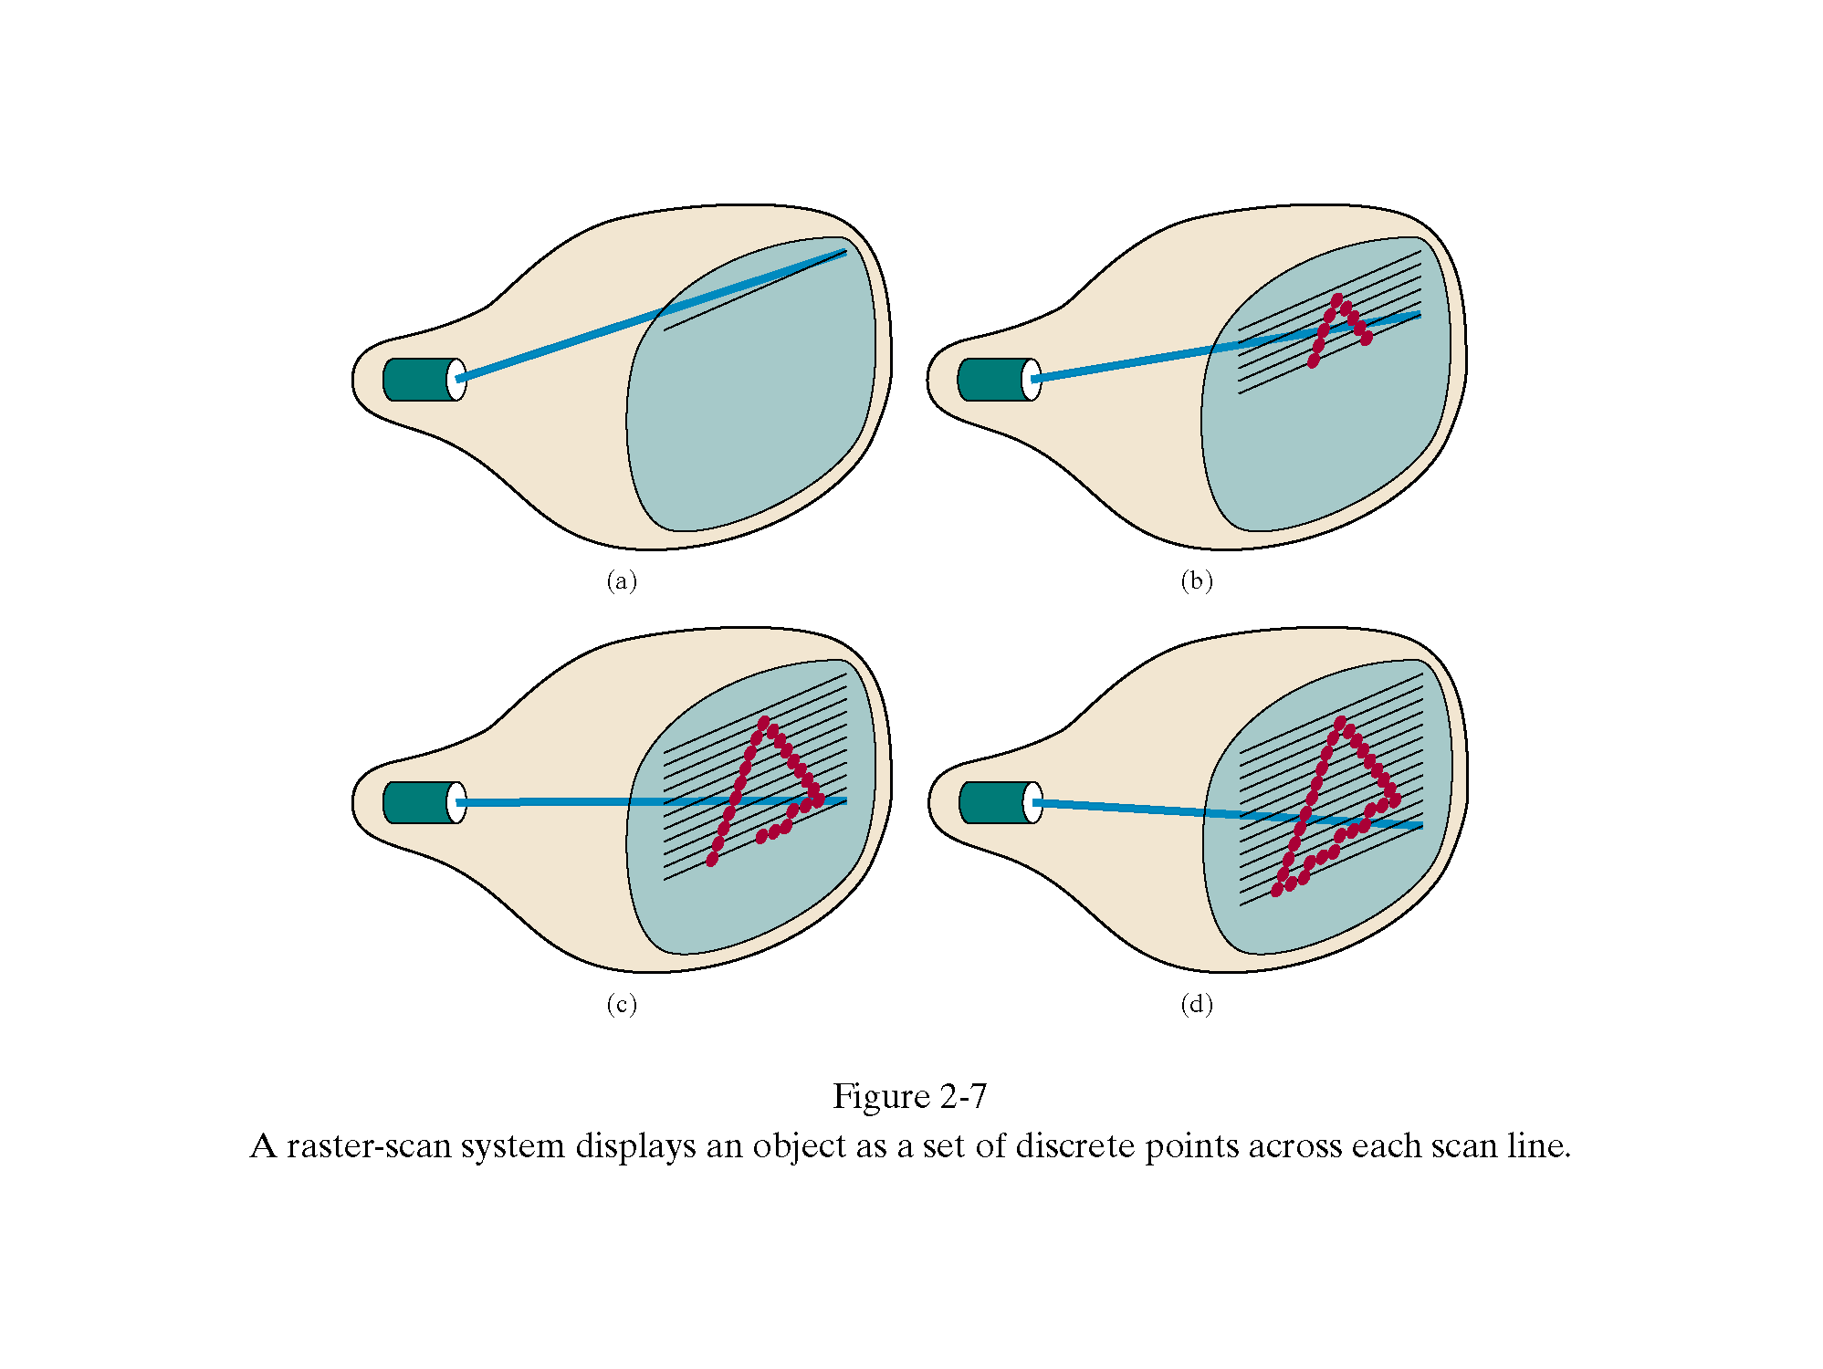
Prepared by Narendra V G CSE MIT

Slide 8
ARCHITECTURE OF A RASTER DISPLAY
INTERFACE WITH HOST COMPUTER
(DIPSLAY COMMANDS) (INTERACTION DATA)
DISPLAY CONTROLLER(DC)
KEYBOARD
MOUSE
000000000000000000000000000000
000000000000000000000111000000
000000000000000000001100000000
000000000000000000000001100000
000000000011110000000000000000
000000011111111110000000000000
000111111111111111111000000000
000111110000000011111000000000
000111111111111111111000000000
000111111110001111111000000000
000111111110001111111000000000
000111111110001111111000000000
000111111111111111111000000000
000000000000000000000000000000
VIDEO CONTROLLER
REFRESH BUFFER
Prepared by Narendra V G CSE MIT

Slide 9
RASTER SCAN AND ADVANTAGES
Scan line
Horizontal retrace
Vertical retrace
Raster Scan
Advantages :
Lower cost ability to display solid colors and patterns
independent of texture and complexity
Disadvantages:
discrete nature of pixel representation(jagged edges) need scan conversion
Prepared by Narendra V G CSE MIT

Slide 10
Basic video controller refresh operations
Raster Scan generator
Horizontal and vertical deflection voltages
X
register
Y
register
Memory address
Pixel register
intensity
Frame Buffer
Prepared by Narendra V G CSE MIT

Slide 11
Vector Scan v/s Raster Scan
Vector Scan | Raster Scan
1. Vector displays draws lines and characters. | 1. Raster display can draw areas filled with colors or patterns.
2. It does not use interlacing. | 2. It uses interlacing.
3. In vector graphics, the beam is moved between the end points of the graphics primitives. | 3. In raster display, the beam is moved all over the screen one scan line at a time from to top to bottom and then back to top
4. These displays have higher resolutions. | 4. These displays have lower resolutions.
5. They are more expensive. | 5. They are less expensive.
6. They draw continuous and smooth lines. | 5. They draw by approximating them with pixel on the raster grid.
7. The refresh rate depends on picture complexity. | 7. The refresh rate is independent of picture complexity.
8. Scan conversion are not required. | 8. Scan conversion are done.
Prepared by Narendra V G CSE MIT

Slide 12
Cathode ray tube
Foremost requirement of a graphics hardware is that the screen should be dynamic.
Refresh rate for raster scan displays is usually 60 frames per second (independent of picture complexity)
  Note that in vector display, refresh rate depends directly on the picture complexity. Greater the complexity, greater the refresh cycle.
Prepared by Narendra V G CSE MIT

Slide 13
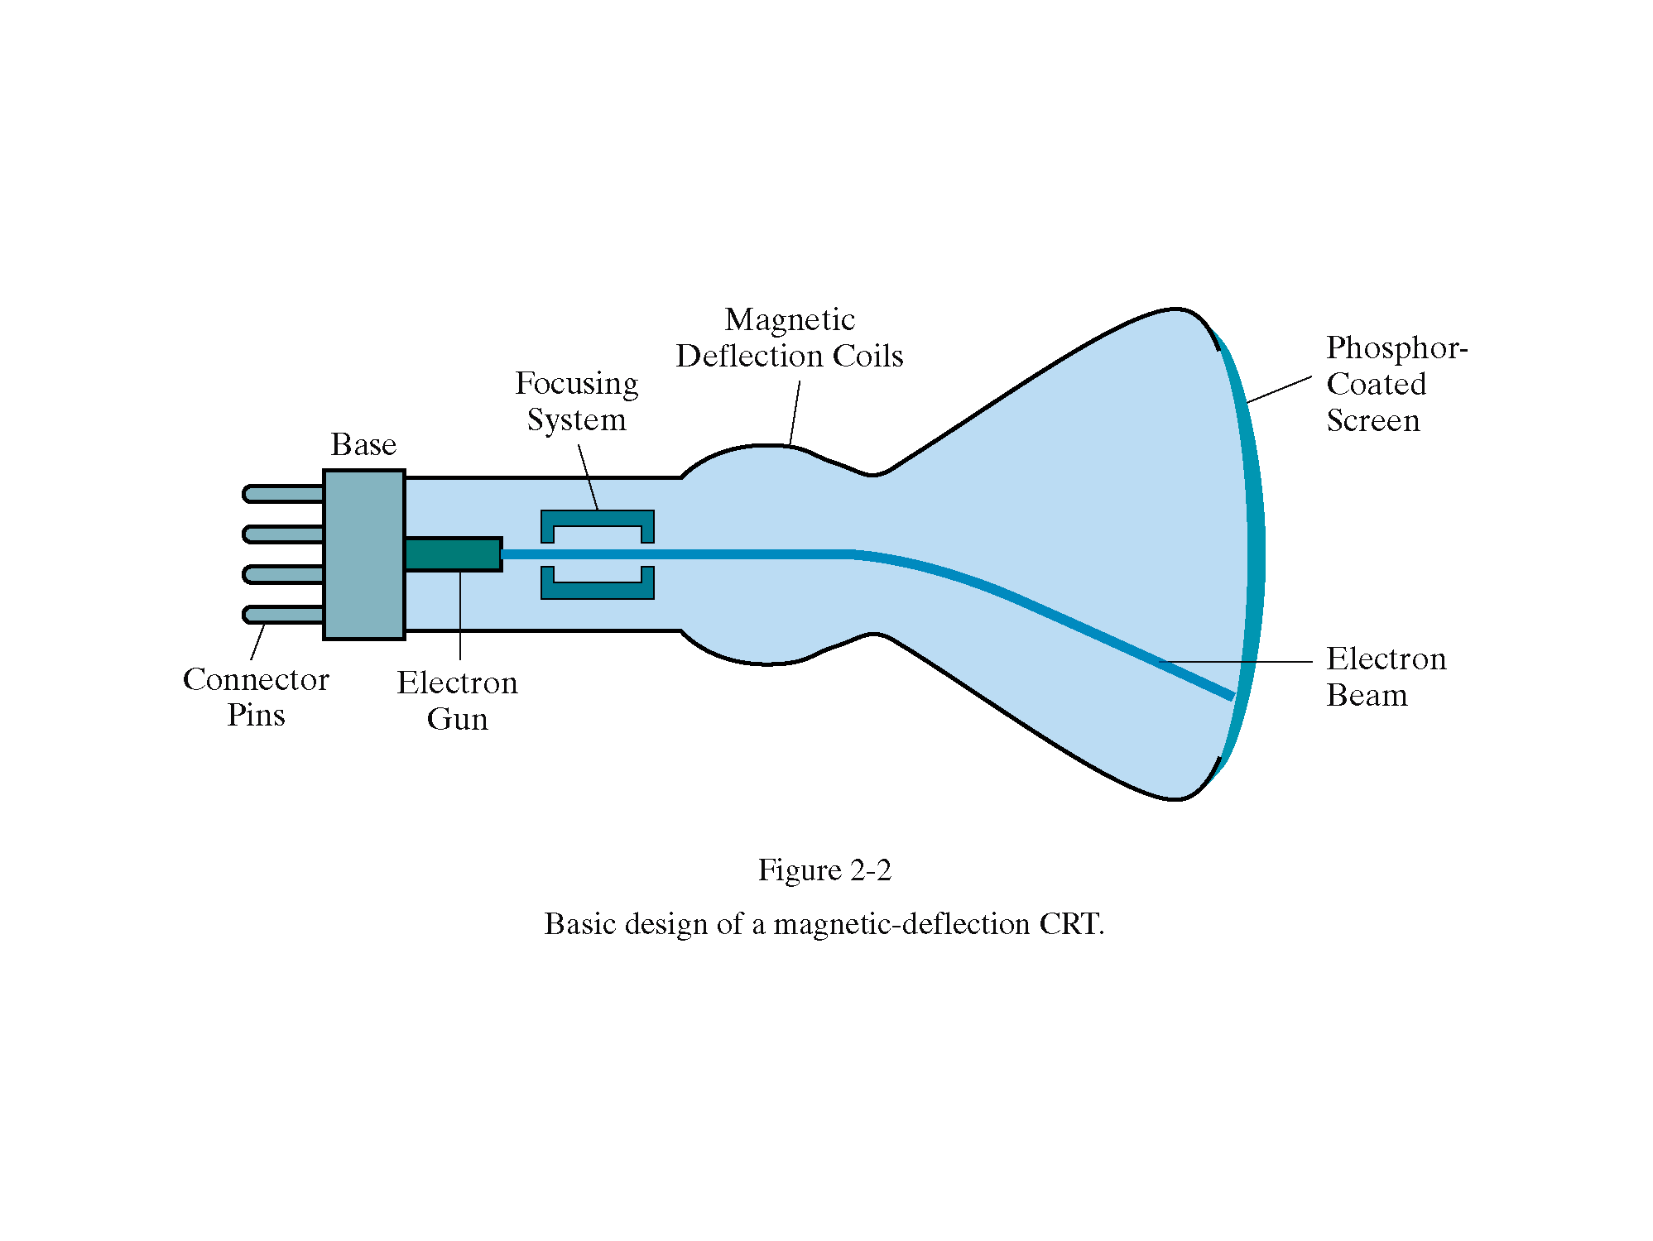
Deflections achieved by adjusting current through
the coils.
Prepared by Narendra V G CSE MIT

Slide 14
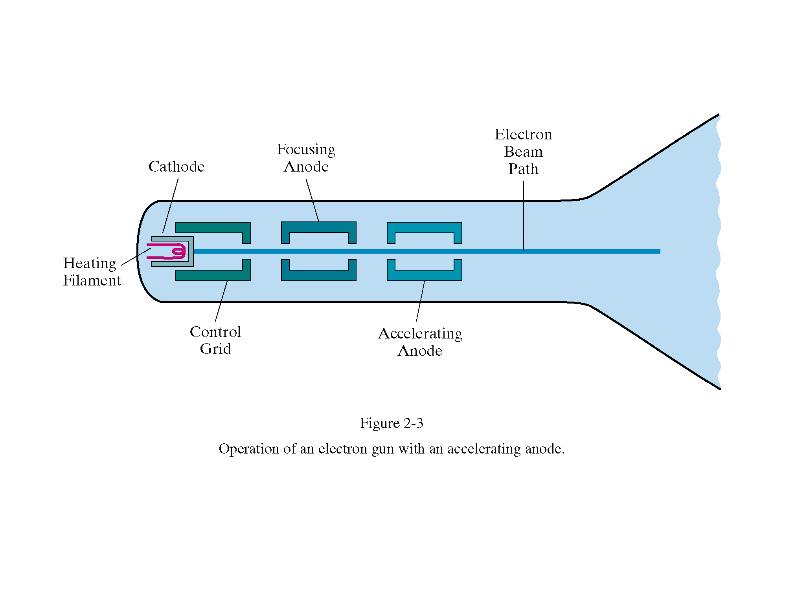
Prepared by Narendra V G CSE MIT

Slide 15
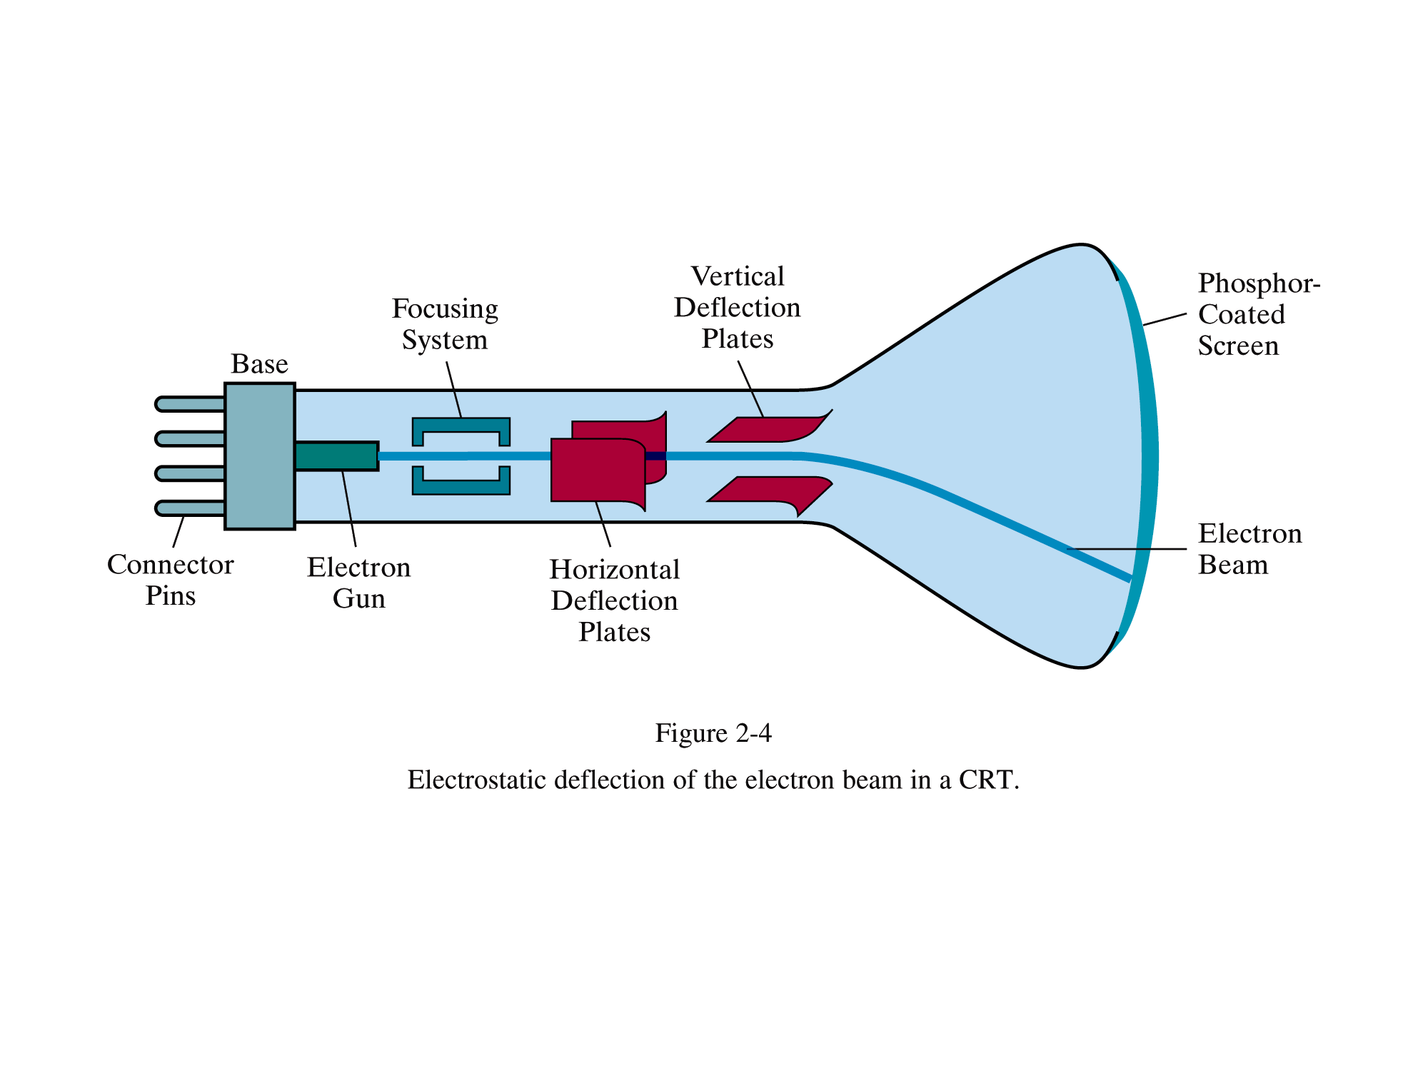
Prepared by Narendra V G CSE MIT

Slide 16
CRT facts
15,000 to 20,000 volts is the voltage used to accelerate the electron beam
Control grid determines how many electrons are in the beam, thus controlling intensity. (The more negative the control-grid voltage is, the fewer the electrons that pass through the grid)
The spot is “focused” in order to cancel the divergence due to repulsion.
Spot is Gaussian distributed (no sharp edge) and is 0.005 inches in diameter.
Prepared by Narendra V G CSE MIT

Slide 17
Fluorescence Vs Phosphorescence
Electron beam hits the phosphor-coated screen with a kinetic energy that is proportional to the acceleration voltage.
Phosphors are characterized by
  color(usually red, green and blue)
  persistence, which is the time for the emitted light to decay to 10% of the initial intensity. High persistence is good for low refresh rates, but bad for animation (“trail” is left behind with moving objects).
Prepared by Narendra V G CSE MIT

Slide 18
Fluorescence Vs Phosphorescence(cont)
When electron beam hits the screen….
After some dissipation due to heat, rest of the energy is transferred to electrons of the phosphor atoms, making them jump to higher quantum energy levels.
The excited electrons then return to their previous quantum levels by giving up extra energy in the form of light, at frequencies predicted by quantum theory.
Prepared by Narendra V G CSE MIT

Slide 19
Fluorescence Vs Phosphorescence(cont)
Any given phosphor has several different quantum levels to an unexcited state. Further, electrons on some levels are less stable and return to the unexcited state more rapidly than others.
A phosphor’s Fluorescence is the light emitted as these very unstable electrons lose their excess energy while phosphor is being struck by electrons.
Phosphorescence is the light given off by the return of relatively more stable excited electrons to their unexcited state once the electron beam excitation is removed.
Typically, most of the light emitted is phosphorescence, since the excitation and the fluorescence usually just lasts a fraction of a microsecond.
Prepared by Narendra V G CSE MIT

Slide 20
Flat-Panel Displays
Class of video devices that have reduced volume, weight, and power requirements compared to a CRT. They are significantly thinner.
Flat panels: i) emissive, ii) nonemissive.
Emissive displays (or emitters) are devices that convert electrical energy into light. Ex. Plasma panels, thin-film electoluminescent displays, Light-Emitting Diodes (LEDs).
(note: Flat CRTs have also been designed but not popular/successful)
Nonemissive flat-panel displays use optical effects to convert sunlight or light from some other source into graphics patterns. Ex. Liquid-crystal device.
Prepared by Narendra V G CSE MIT

Slide 21
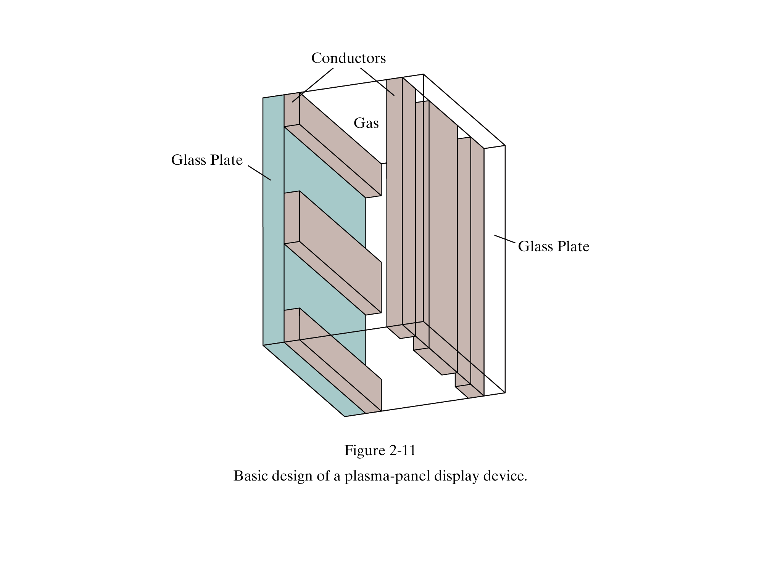
Prepared by Narendra V G CSE MIT

Slide 22
Plasma panels
Constructed by filling the region between glass plates with a mixture of gases, usually including neon.
A series of vertical conducting ribbons is placed on one glass panel, horizontal on the other.
Voltages are fired to an intersecting pair to break down a glowing plasma of electrons and ions. Refresh rate is 60 frames per sec.
Prepared by Narendra V G CSE MIT

Slide 23
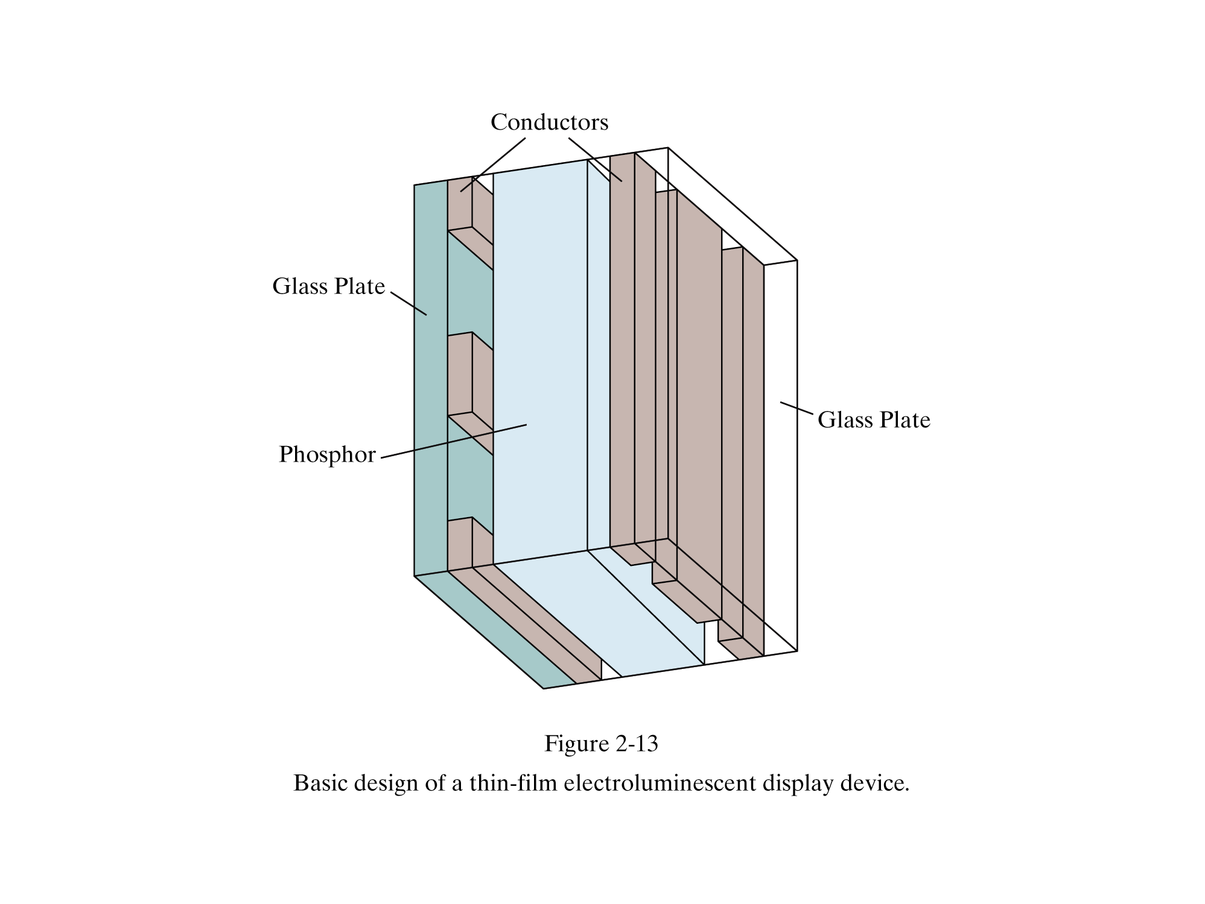
Prepared by Narendra V G CSE MIT

Slide 24
Display Technology: LCD
Liquid Crystal Displays (LCDs)
  Liquid crystal – these compounds have a crystalline arrangement of molecules, yet they flow like a liquid
  LCSs are commonly used in small systems such as laptops, calculators
  LCDs: organic molecules, naturally in crystalline state, that liquify when excited by heat or E field
  Crystalline state twists polarized light 90º
Prepared by Narendra V G CSE MIT

Slide 25
LCD..
Produces a picture by passing polarized light from the surroundings or from an internal light source through a liquid-crystal material that can either block or transmit the light.
The intersection of the two conductors defines a pixel position.
Polarized light is twisted as it passes through the opposite polarizer. The light is then reflected back to the viewer.
To turn off the pixel, voltage is applied to the two intersecting conductors to align the molecules so that the light is not twisted.
Prepared by Narendra V G CSE MIT

Slide 26
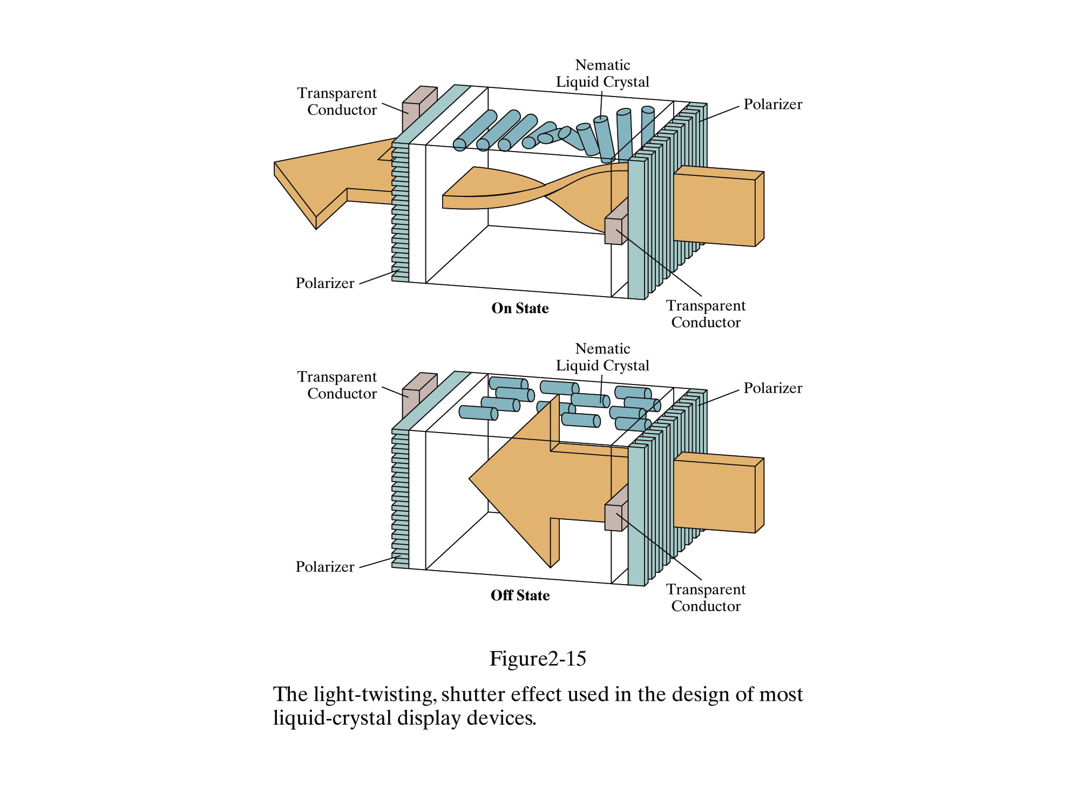
Prepared by Narendra V G CSE MIT

Slide 27
Color
Color is achieved by having three electron guns mixing the colors red, green and blue (RGB).
White is perceived when all are illuminated and when all are off its black.
Typically each color is specified by an 8-bit value . Thus 8*3=24 bits are needed to represent a color pixel(also called true color).
Prepared by Narendra V G CSE MIT

Slide 28
Color (cont)
256 entry
8bits
24 bits
Storing say 24 bits of information for each pixel of a (say), 1000*1000 screen eats up 3 Megabytes of memory. Thus low end graphics workstations use a more economical approach. They use 8 bits per pixel where each 8-bit entry is an index into a 256-entry color map. Each entry in the color map is a 24-bit value containing R,G,B components of the color. This is color-Indexing.
Prepared by Narendra V G CSE MIT

Slide 29
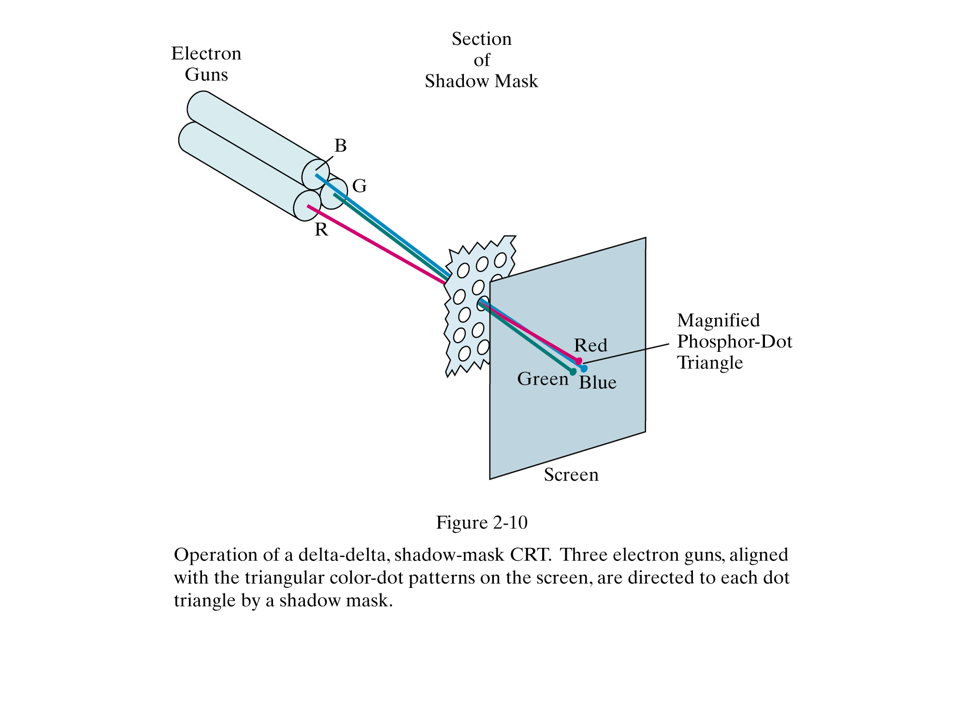
Prepared by Narendra V G CSE MIT

Slide 30
Frame Buffer
A frame buffer is a large contiguous piece of computer memory.
  At a minimum, there is one memory bit for each pixel (picture element) in the raster; this amount of memory is called bit plane
  A 1024 * 1024 element square raster requires
  2 ²⁰ or 1,048,576 ( 2¹⁰*2¹⁰) memory bits in a single bit plane. Each bit has 2 states (monochrome display).
  Conversion from digital to analog is done by DAC (digital-to-analog converter).
Prepared by Narendra V G CSE MIT

Slide 31
Frame Buffer raster CRT device
1
DAC
Register
Electron Gun
Frame Buffer
CRT Raster
A single-bit-plane(1 bit per pixel) Black and White frame buffer raster CRT graphics device
Prepared by Narendra V G CSE MIT

Slide 32
Color and Gray levels
Color or gray levels are incorporated into a frame buffer by adding additional bit planes.
The binary value from each of the N bit planes is loaded into corresponding positions into a register. The resulting binary number is interpreted as an intensity level between 0 (dark) and 2^{N}-1(full intensity)
A Raster with 3 bit planes generates 8 (2³) intensity levels. In this case, the frame buffer should have 3,145,728 ( 3 * 1024 * 1024) memory bits.
Prepared by Narendra V G CSE MIT

Slide 33
An N bit gray level frame buffer
Register
N
N
0
0
1
0 1 0
2
2^{N} DAC
Electron gun
N=3 2^{N} levels
Frame Buffer
CRT Raster
Prepared by Narendra V G CSE MIT

Slide 34
Simple color frame buffer
0
0
DAC
3
1
0
1
DAC
0
DAC
Frame Buffer
CRT RASTER
Prepared by Narendra V G CSE MIT

Slide 35
3 Bit plane frame buffer color combinations
 | Red | Green | Blue
Black | 0 | 0 | 0
Red | 1 | 0 | 0
Green | 0 | 1 | 0
Blue | 0 | 0 | 1
Yellow | 1 | 1 | 0
Cyan | 0 | 1 | 1
White | 1 | 1 | 1
Prepared by Narendra V G CSE MIT

Slide 36
A 24 Bit plane color frame buffer
8
registers
Color Guns
0 1 0 0 1 0 1 1
3 bit DAC
Blue 75
8
1 0 1 0 1 1 0 0
3 bit DAC
Green 172
8
0 0 0 0 1 0 1 0
3 bit DAC
Red 10
CRT Raster
Frame Buffer
Prepared by Narendra V G CSE MIT

Slide 37
Gray Level Frame Buffer with Look Up table
0
1
2
10
Electron Gun
0 1 0
1
0
1
0
2w DAC
0
2^{N} entries
Frame Buffer
N=3
Lookup tables
W=4
An N Bit plane Gray Level frame buffer, with W-bit-wide lookup table
CRT Raster
Prepared by Narendra V G CSE MIT

Slide 38
Color frame buffer(24 bit plane) with lookup tables(10 Bit wide)
W=10
W=10
W bit DAC
W bit DAC
CRT Raster
N=8
2^{N} entries
W bit DAC
Prepared by Narendra V G CSE MIT
W=10

Slide 39
Resolution
Resolution
  The Maximum number of points that are displayed without overlap.
  This is usually given as the number of horizontal points versus the number of vertical points. These points are called pixels or picture elements.
The maximum resolution may be determined by the characteristics of the monitor for a random scan system or by a combination of monitor and graphics card memory for a raster scan system.
Typical resolution on high-quality systems is 1280 by 1024, higher also available.
Physical size of the graphics monitor is measured as length of the screen diagonal which generally varies from 12 in. to 27in.
Prepared by Narendra V G CSE MIT

Slide 40
Aspect Ratio
Aspect Ratio
  The aspect ratio is the ratio of horizontal dimension/vertical dimension.
Example
  If the monitor dimensions are 8 inches by 6 inches, the aspect ratio is 8/6 which is equal 1.33.
  If the resolution of the screen is 640 by 480, the length of the pixel is 640/8 equal to 80 pixels per inch. Similarly height is 480/6 equal to 80 pixels per inch. Thus the pixel is a square.
If the horizontal size of a pixel is not equal to the vertical size, then it must be corrected for image display else the image will appear distorted.
Prepared by Narendra V G CSE MIT

Slide 41
Image resolutions in practice
WORKSTATIONS
  Bitmapped display 960 * 1152* 1b approx 1MB
  Color Display 1280* 1024*24b approx 5MB
TELEVISION
  NTSC 640*480*8b approx ¼ MB
  HDTV 1980*1080*8b approx 2 MB
LASER PRINTERS
  300 dpi (8.5*300)(11*300) approx 1.05 MB
  2400 dpi (8.5*2400)(11*2400) approx 64MB
Prepared by Narendra V G CSE MIT

Slide 42
Speed requirements and scanning rates
Speed requirements for memory access
    1024*768*8 = 768 Kbytes= 786,432 bytes
    Read 786*10³ bytes in 1600*10⁻⁵ secs (inverse of 60) for 60 HZ.
Rough estimation of scanning rates.
  Frequency X number of vertical lines (note scan always means a full horizontal scan)
    Example: for an IBM VGA 60*480 = 30 HZ
    For 1024 * 768 = 46 Khz
Prepared by Narendra V G CSE MIT

Slide 43
Dot size and Addressability
The image quality achievable with display devices depends on both the addressability and the dot size of the device.
Dot (spot) size is the diameter of the single dot created on the device.
Addressability is the number of individual dots per inch that can be created; it may differ in horizontal and vertical directions.
Addressability in x is the reciprocal of the distance between the centers of dots at addresses (x,y) and (x+1,y). Similarly the other direction is calculated.
Prepared by Narendra V G CSE MIT

Slide 44
Interdot distance
Interdot distance is the reciprocal of addressability
It is usually desirable that the dot size be somewhat greater than the interdot distance, so that smooth shapes can be created.
Prepared by Narendra V G CSE MIT

